Slide 1
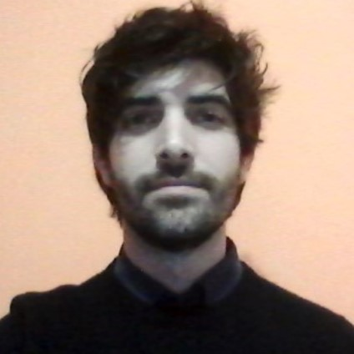

ism6331 INFORMATION SECURITY SYSTEMS
Nicholas Catani

Slide 2
AGENDA
- Introduction
- Accomplishment
- Technology frustration
- Security/privacy concern

Slide 3
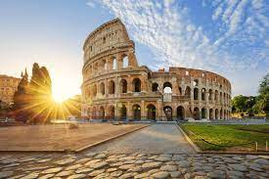
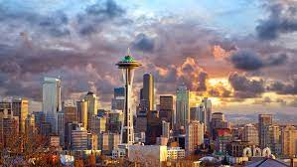


INTRODUCTION
I am from Rome - Europe.
I live in Capitol Hill - Seattle.
I just listen to Grunge music.
I am a voracious reader, always on to learn something new.

Slide 4
Accomplishment
Glad to have completed a 6-months professional certificate in Data Science from MITx.
I got to play with extravagant algorithms using python – built software program for a vacuum cleaner that maps an entire room just to mention one.

Slide 5
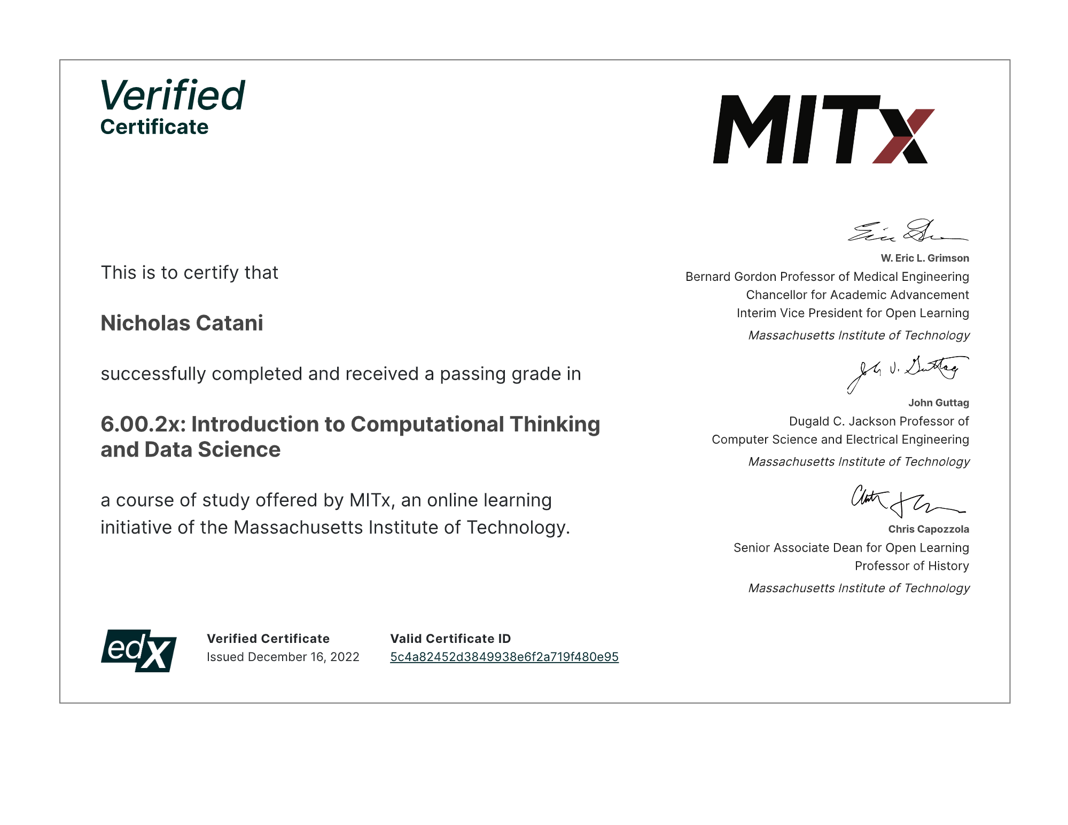

Slide 6
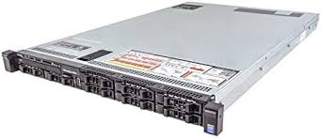
Technology frustration
Working at the CIS as IT tech, I’ve received a ticket from OSS last week. One of their server went down. After few days of testing and diagnostic, I figured that the server fails the hard drive testing.
Stuck at the RAID configuration and still seeking for a solution.

Slide 7
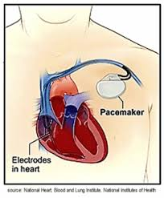
Security/privacy concern
In information system management, Prof. Steinke taught us the importance of having strong security measures to protect our computer systems. That being said, how can we protect some pieces of technology that keep us alive such as pacemakers from cyberhackers?

